Slide 1














File
Format
Presented by Group 1

Slide 2


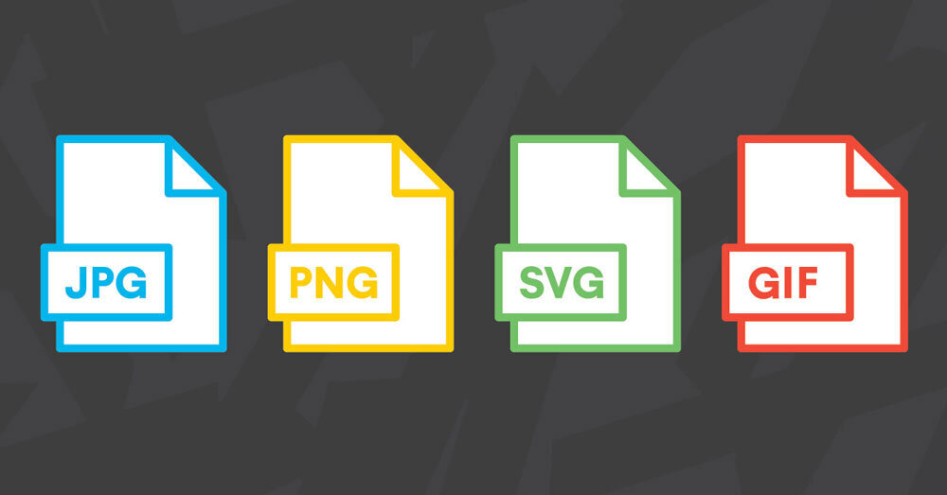

Introduction
What is a File Format?
A file format is a standardized way of organizing and storing data in a computer file. It defines the structure and encoding of information within the file, allowing different software applications to interpret and process the data consistently.
File formats serve as a set of rules that dictate how data should be arranged, represented, and stored, ensuring compatibility between various software programs and systems.

Slide 3
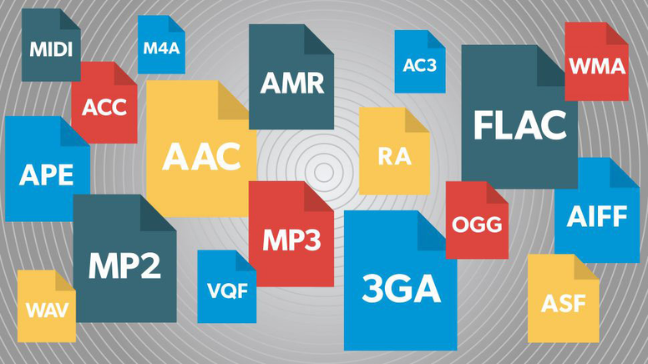
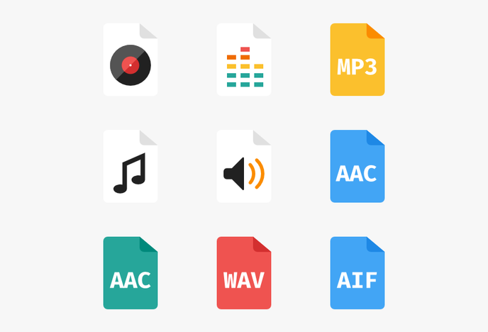
Audio File Formats
An audio file format is a file format for storing digital audio data on a computer system.
Each format has its own characteristics, compression methods, and intended use cases.
Most Know audio format are the following:
MP3 (MPEG Audio Layer III)
WAV (Waveform Audio File Format)
FLAC (Free Lossless Audio Codec)
AAC (Advanced Audio Coding)

Slide 4
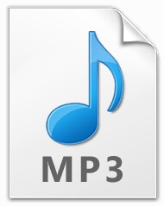
MP3 ( MPEG Audio Layer III )
MP3 is a widely used audio compression format that reduces file sizes while maintaining reasonable sound quality.
It achieves compression by removing some audio data that is less perceptible to the human ear.
Advantages:
Small file sizes, making it suitable for streaming and portable devices.
Broad compatibility with a wide range of devices and software.
Disadvantages:
Lossy compression may result in some loss of audio quality.
Audiophiles may prefer lossless formats for higher fidelity.

Slide 5

WAV (Waveform Audio File Format)
WAV is an uncompressed audio format that preserves the original quality of the recording.
It is commonly used for high-fidelity audio and is known for its flexibility in supporting various audio codecs.
Advantages:
Uncompressed, lossless format ensures no loss of audio quality.
Suitable for professional audio production and editing.
Disadvantages:
Large file sizes, which may be impractical for storage and streaming.
Limited metadata support compared to some other formats.

Slide 6


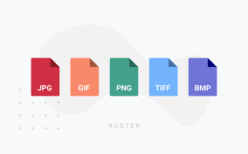

Image File Formats
Image file formats are standardized ways of organizing and storing digital images.
These formats determine how image data is structured, encoded, and stored, influencing factors such as image quality, file size, and compatibility with various software and devices.
Most Know Image format are the following:
JPEG (Joint Photographic Experts Group)
PNG (Portable Network Graphics)

Slide 7
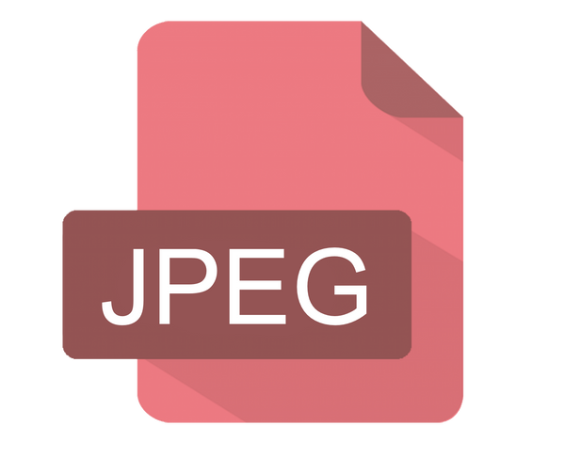
JPEG (Joint Photographic Experts Group)
JPEG is a widely used image compression format that achieves significant file size reduction by selectively discarding image data.
It is particularly suitable for photographs and images with complex color gradients.
Advantages:
High compression efficiency, resulting in smaller file sizes.
Broad compatibility with most devices and software.
Disadvantages:
Lossy compression may lead to a reduction in image quality.
Not ideal for images with sharp edges or text, as artifacts may occur.

Slide 8

PNG (Portable Network Graphics)
PNG is a lossless image compression format designed for web use.
It supports transparency and is suitable for images with sharp edges, text, and simple graphics.
Advantages:
Lossless compression, preserving image quality without artifacts.
Support for transparent backgrounds.
Disadvantages:
Larger file sizes compared to JPEG, especially for complex images.
Less effective for compressing photographs with continuous tones.

Slide 9
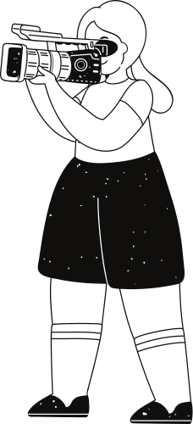
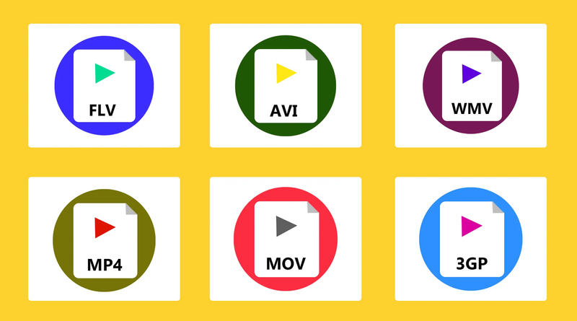
Video File Formats
Video file formats are standardized methods of organizing and storing digital video data.
These formats determine how video data is compressed, encoded, and stored, affecting factors such as video quality, file size, and compatibility with different devices and platforms.
Most Know audio format are the following:
MP4 (MPEG-4 Part 14)
AVI (Audio Video Interleave)
MKV (Matroska)

Slide 10

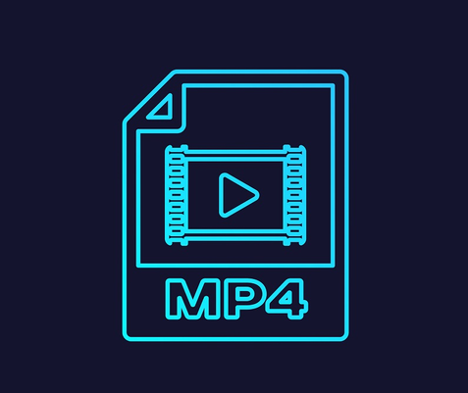
MP4 (MPEG-4 Part 14)
MP4 is a widely used video container format that can store video, audio, subtitles, and other data.
It uses the H.264 or H.265 (HEVC) video codecs for compression.
Advantages:
Excellent compression efficiency, resulting in relatively small file sizes with high video quality.
Broad compatibility with a wide range of devices and platforms.
Disadvantages:
Lossy compression may result in some loss of video quality.
Editing MP4 files can be challenging, especially when dealing with certain codecs.

Slide 11
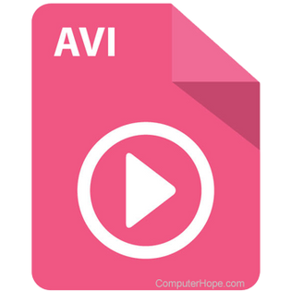
AVI (Audio Video Interleave)
AVI is an older and widely supported video container format developed by Microsoft.
It can contain both audio and video streams using various codecs.
Advantages:
Compatibility with a variety of codecs and software applications.
Can store high-quality video and audio.
Disadvantages:
Larger file sizes compared to more modern formats.
Limited support for advanced features like subtitles and multiple audio streams.

Slide 12
Thank you very much!

